Slide 1
Downtime Enhancement – Quick Complete
Suggest ‘Top X’ reasons for simplified data entry
Top X
For each DTRP/Location
Probability %
Cause Location
Classification
Cause
Effect
‘Probability %’ indicates percentages of records associated with each combination.
Production Analyst
Data Grid Context Menu (right-click) offers “Top X” combinations for quick data entry
RCE
Provides “Top X” info in message for use by Skelta/MSFlow/Slack/Email as quick data entry options
Webhook
Provides “Top X” info in message for use by Skelta/MSFlow/Slack/Email as quick data entry options

Slide 2
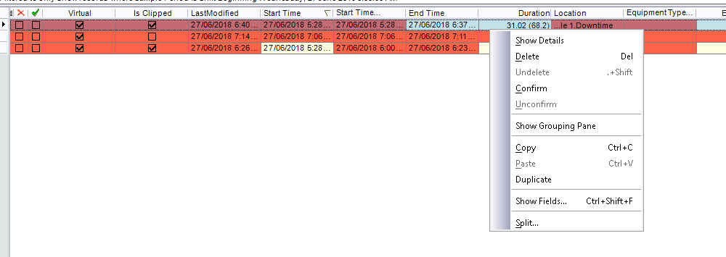
Downtime Enhancement – Quick Complete
Example – Production Analyst
Quick Complete
No Feed | Operating Delay Enterprise.Site A.ROM (53%)
Stockpile Full | Operating Delay Enterprise.Site A.Product SP (12%)
Blocked | Unscheduled Failure Enterprise.Site A.Crushing.Crusher A (6%)
Crusher Gap | Performance Loss Enterprise.Site A.Crushing.Crusher A (3%)
Wet Feed | Performance Loss Enterprise.Site A.Crushing.Crusher A (1%)
Cause | Effect (if not null)| Classification Cause Location (Occurrence %)

Slide 3
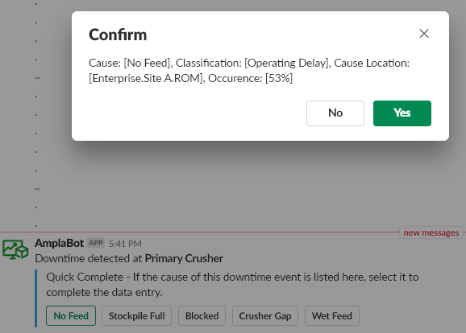
Downtime Enhancement – Quick Complete
Example – Outlook/Skelta/Slack

