Slide 1
OCT 2020
Shaping the Future of Industries
Your Partner in Digital Transformation
Presented by: Zhang Sheng Tan
©2020 AVEVA Group plc and its subsidiaries. All rights reserved.
1

Slide 2
Why Enable Low Coding?
Challenge
First time BI Gateway Users might be lost while using the product due to inexperience or unfamiliarity
Solution: Low Coding Environment
Allow first time user to quickly pick up the language and utilize BI Gateway right away by providing a guidance platform experience as well as a “drag & drop” kind of low level coding.

Slide 3
Simplified Query Experience -Example
After
Input
Scope
Inputs
FQN
Q
CQAnalogSummary
Select
Column
Before
BIGateway_PlantID
{
"QueryName": "CQAnalogsummary",
"SelectColumn": ["FQN","BIGateway_PlantID AS PlantID","BIGateway_AssetID AS AssetID","StartDateTime","Average"],
"Tag": {
"Filter": "BIGateway_MeasureCalculation eq 'Efficiency'",
"Select": "FQN,BIGateway_MeasureCalculation,BIGateway_PlantID,BIGateway_AssetID"
},
"StartDateTime" : "[RequestedStartTime]",
"EndDateTime": "[RequestedEndTime]"
}
BIGateway_AssetID
Filter
BIGateway_
MeasuredCalculation
Output
FQN
Select
Efficiency
BIGateway_PlantID
BIGateway_AssetID
BIGateway_
MeasuredCalculation

Slide 4
Low Code experience:Step 1
:Returns summary values for analog tags selected
Select type of query to execute, Automatic generation of suggestions
1. Select type of query
Q
CQAnalogSummary
When user hover mouse over a type of query: Give explanation of what it is
Q
TagMetaData
Q
AnalogSummary
Q
Process value
Suggestions given to user to start their first query experience
Guide the user :First block that user need to select

Slide 5
Low Code experience:Step 2
User Selected the type of query he wants: CQAnalogSummary
2. Select Inputs/Outputs
When user click on inputs, automatically refresh the suggestions that is available to user
Select
Column
Inputs
Filter
Q
CQAnalogSummary
Output
Suggestions given to user to start their first query experience
Guide the user :Second block that user need to select

Slide 6
Low Code experience(Step3)
User Selected the type of query he wants: CQAnalogSummary →Input→Select column
2. Select Inputs/Outputs
FQN
Select
Column
Inputs
BIGateway_PlantID
Q
CQAnalogSummary
BIGateway_AssetID
BIGateway_
MeasuredCalculation
Output
Suggestions given to user to start their first query experience
Guide the user :Second block that user need to select

Slide 7
Low Code Experience:End Result
Inputs
FQN
Q
CQAnalogSummary
Select
Column
BIGateway_PlantID
REPEAT THE Necessary step by step drag & drop……………… Till we get the final query to execute!
BIGateway_AssetID
Output
Filter
BIGateway_
MeasuredCalculation
FQN
Select
Efficiency
BIGateway_PlantID
BIGateway_AssetID
BIGateway_
MeasuredCalculation

Slide 8
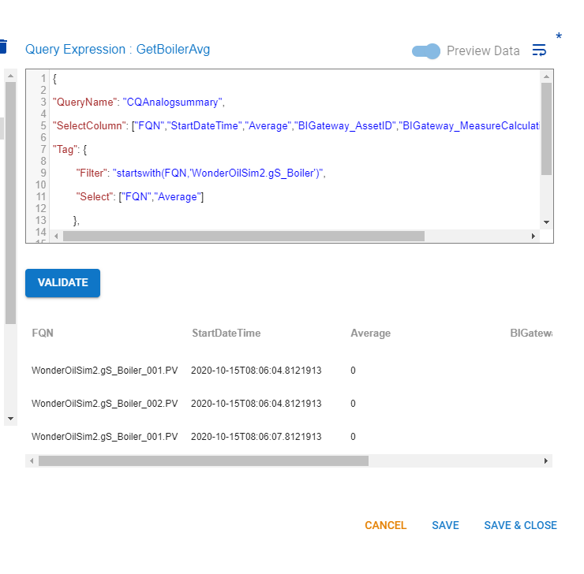
Low Code Experience:End Result
Inputs
FQN
REPEAT THE Necessary step by step drag & drop……………… Till we get the final query to execute!
Q
CQAnalogSummary
Select
Column
BIGateway_PlantID
BIGateway_AssetID
Output
Filter
BIGateway_
MeasuredCalculation
FQN
Select
Efficiency
BIGateway_PlantID
BIGateway_AssetID
BIGateway_
MeasuredCalculation

Slide 9
©2020 AVEVA Group plc and its subsidiaries. All rights reserved.
9

Slide 10
©2020 AVEVA Group plc and its subsidiaries. All rights reserved.
10

Slide 11
©2020 AVEVA Group plc and its subsidiaries. All rights reserved.
11

